Slide 1
Introduction to Accessible Simple Images
Teaching, Transformation, and Development Academy

Slide 2
Disclaimers
This workshop focuses on simple images
This workshop focuses on digital images
This workshop will focus on best practices for writing image descriptions

Slide 3
Technical Support for Simple Images
Not sure how to add in alt-text to simple images in Microsoft Word, Microsoft PowerPoint, and Blackboard Ultra?
Head over to TTaDA’s Creating Accessible Content website.

Slide 4
Workshop Goals
By the end of this workshop, you should be able to:
Identify the two parts needed to make images accessible
Distinguish between captions and alternative text
Identify best practices when writing image descriptions
Identify common pitfalls when writing image descriptions

Slide 5
Making Simple Images Accessible

Slide 6
The Problem, Part 1
Users who can see images can understand and decipher the content in a digital image on a phone, laptop, or desktop screen.

Slide 7
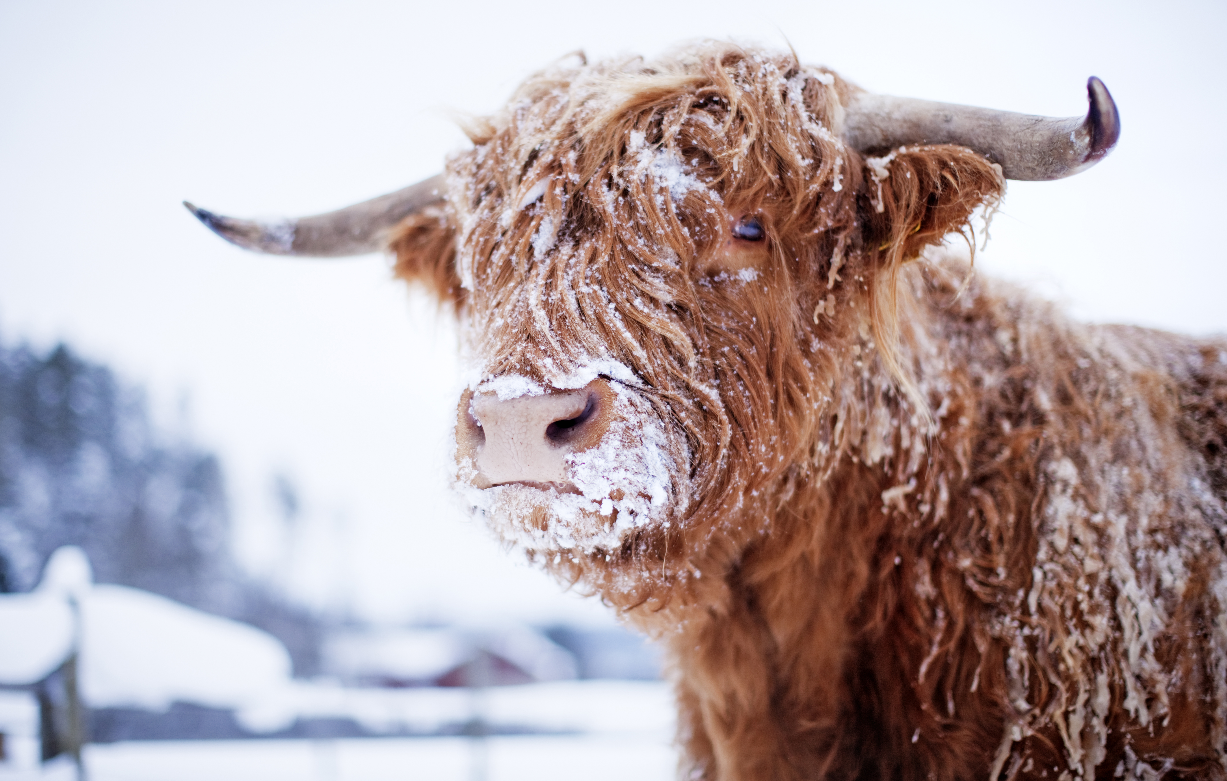
Image Example

Slide 8
The Problem, Part 2
What happens if you can’t see the screen/image, however?
Would you purchase the cow if you couldn’t see the image posted on a website?
In an educational context like ours, what happens if you’re a student who can’t see the image, but you have to answer a test question, complete an activity, or submit an assignment based on your understand that image?

Slide 9
Enter Screen Readers
To recap
Screen Readers are robust technologies that read screens aloud
They require code to identify different elements on the screen

Slide 10
The Problem, Part 3
When screen readers encounter images, the following (doesn’t) happen:
Screen readers can’t describe the content of images
Screen readers encounter an image and announces either Image or Image of and keep on going
Learners who can’t see screens or images are then excluded from the product, the learning activity, etc.

Slide 11
The Solution
Provide a textual alternative to the image that uses description to “translate” the image into text
Alternative text or “alt-text”
Without alternative text or image descriptions, learners remain excluded – not the effect we’re aiming for!

Slide 12
Adding Alternative Text (Alt-Text)
Alt-text is comprised of two distinct parts:
The HTML tag (piece of code) <alt>
A brief description of what is in the image, which must be written and supplied by a Subject Matter Expert
The screen reader is prompted by the <alt> tag to announce whatever comes after it, and then it will read whatever is supplied in the brief description.

Slide 13

Alt-Text Example
<alt>Four cupcakes with swirls of baby pink frosting arranged in a circle.

Slide 14
Location
Alt-text rarely, if ever, appears on a screen!

Slide 15
Why Use Alternative Text?

Slide 16
Alternative Text Helps!
The following groups of users and learners benefit from alternative text.
Screen reader users
Internet users with a slow connection/browser that has blocked images
Content developers

Slide 17
Broken Images
When images are broken because internet connections are slow/bad and images can’t be displayed, users who can see screens can also read alt-text.
These users can include (but are not limited to the following):
Unhoused folks
Folks in rural areas
Economically-disadvantaged folks
Folks who have bad internet connection

Slide 18
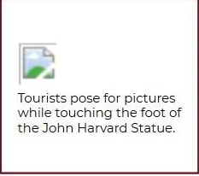
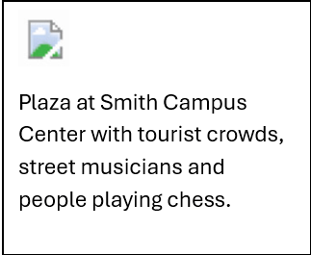
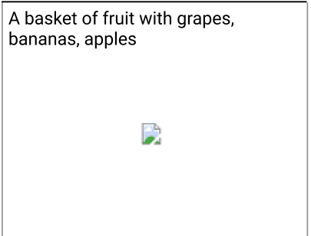
Broken Images Examples
Here are some examples of alt-text that display when the image is broken.

Slide 19
Alternative Text Best Practices

Slide 20
What Needs Alternative Text?
Knowing what needs alternative text added to it is the first step in writing effective image descriptions.
Pictures, images, clip art, icons
Video (if embedded in Word, PowerPoint, Excel, or Blackboard)
Shapes and Smart Art shapes
Tables, Charts, and Graphs

Slide 21
Writing Alt-Text: DO
When you write image descriptions, here are some things to keep in your front lobes.
  Aim for about 120 characters of text or 1-2 sentences
  Be specific & accurate with your alt-text
  Be objective & neutral in your descriptions
  Consider your intended audience and what they need to understand the image
  Be careful when marking images as decorative

Slide 22
Writing Alt-Text: Being Specific & Accurate
Being specific and accurate with your alt-text is key.
Beware AI-generated alt-text. This alt-text tends to be very general and vague – to the point of inaccuracy.
Use objective descriptive language to describe the image’s contents. The goal of alt-text is not to interpret an image, just to get across its key details.

Slide 23
Alt-Text Activity

Slide 24
Alt-Text Activity Rules
To complete this activity, here’s what we will do.
I will say a sentence out loud to you without showing you a pre-selected image.
You need to either jot down or make a mental note of the very first image that springs to mind when you hear the sentence.
We will come back together and compare notes.

Slide 25
The Sentence
Old lady in hat.

Slide 26
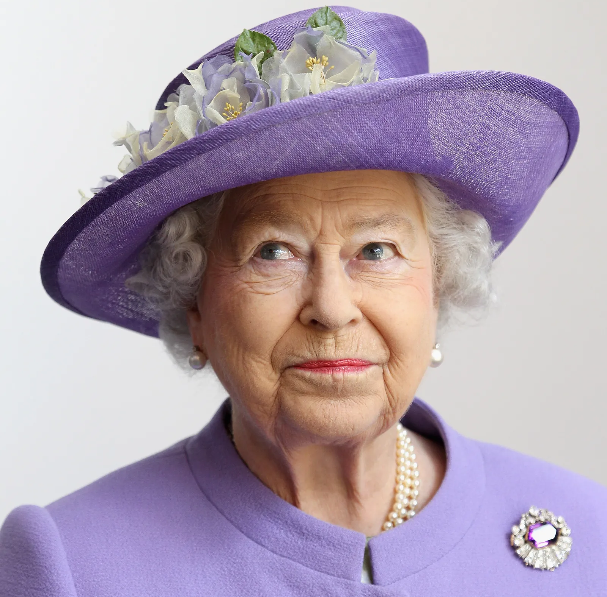
Surprise!
Were you expecting this old lady in hat?

Slide 27
More Specific and Accurate Alt-Text
Here is a more effective alternative to “old lady in hat.”
“Portrait of Queen Elizabeth II, wearing a lavender ensemble, including flower-brimmed hat, looking upward.”

Slide 28
Writing Alt-Text: AVOID
Here are some things to avoid when writing alt-text:
Starting your alt-text off with the words “Image” or “Image of”
Including every detail in the image
Confusing image captions with alt-text
Using inaccurate or subjective alt-text
Relying on auto-generated alt-text – AI-generated descriptions might get you started but they tend to fall into “old lady in hat” territory

Slide 29
Avoid including every detail in the image
To help you figure out which details to include and which to discard, ask yourself the following?
What is the instructional purpose of this image? What specific objective (either course level or lesson-level) does this image support?
What specific details do my learners need to in order for them to complete course interactions, activities, and assessments?
Then include just those details. It is OK to leave some details out!

Slide 30
Samples

Slide 31
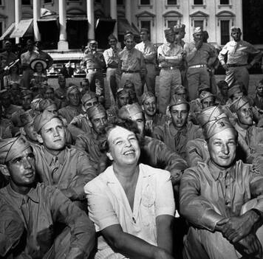
Accuracy Example #1
A group of people in uniform

Slide 32
Accuracy Example #2
A group of uniformed soldiers and a woman wearing white

Slide 33
Accuracy Example #3
A group of uniformed soldiers and a woman wearing white in front of the White House in Washington, DC

Slide 34
Accuracy Example #4
Black and white photo of a smiling Eleanor Roosevelt sitting with a group of uniformed troops on the lawn in front of the White House.

Slide 35
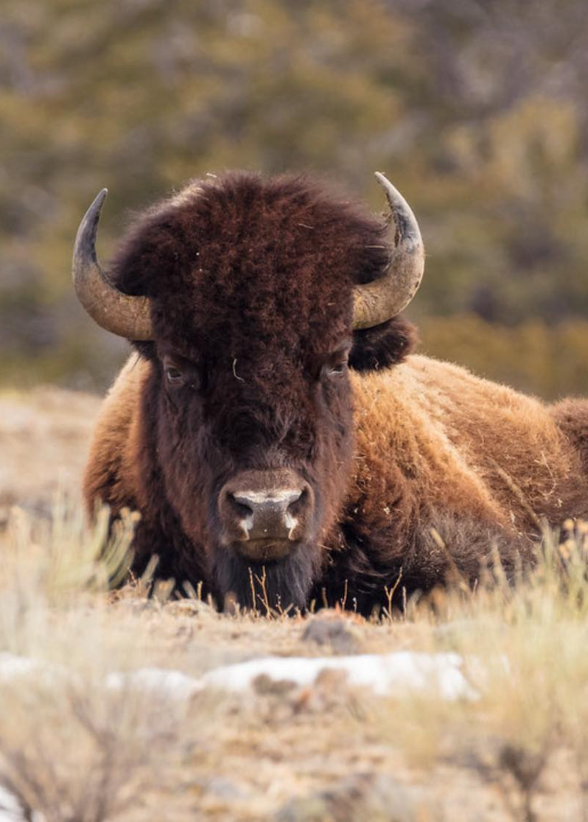
Example #1: Simple Image
This image appeared on the National Park Service’s social media to advertise for the annual Bison Trot – which are informal exercise opportunities in the parks at Thanksgiving time.
Alt-text: A bison not trotting and sitting stoically.

Slide 36
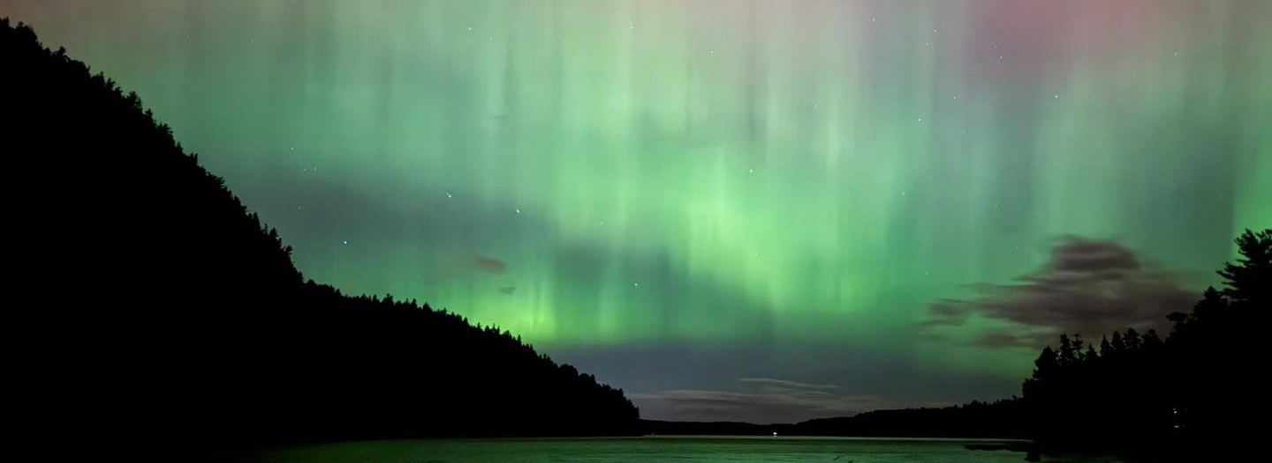
Example #2: Landscape
This image appeared on the National Park Service’s social media to advertise sky and star-gazing opportunities.
Alt-text: Pink and green hues illuminate the night sky above Acadia National Park.

Slide 37
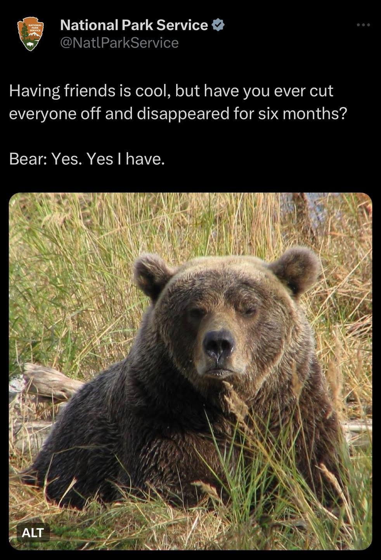
Example #3: Image with Text
Graphic with an aloof bear with text, “Having friends is cool, but have you ever cut everyone out and disappeared for six months. Bear: Yes. Yes I have.”

Slide 38
Thank you!
Notes:
Please Note: This template has been created using the University of North Dakota brand guidelines. All colors and typefaces/fonts are within the brand guidelines and altering them isn’t suggested. Please visit UND.edu/brand for more information on using the UND brand or email identity@UND.edu with any UND branding questions.
DON’T FORGET TO CHECK THE PRESENTATION FOR ACCESSIBILITY!
To Check Presentation Accessibility:
1.) Click on Review Tab
2.) Click Check Accessibility
3.) Window will open on right side of the screen
4.) Click on specific result for steps to fix the error and an explanation on why it needs fixing

