Slide 1
Introduction to Accessible Complex Images
Teaching, Transformation, and Development Academy (TTaDA)
University of North Dakota
Notes:
Please Note: This template has been created using the University of North Dakota brand guidelines. All colors and typefaces/fonts are within the brand guidelines and altering them isn’t suggested. Please visit UND.edu/brand for more information on using the UND brand or email identity@UND.edu with any UND branding questions.
TIPS:
Check out the Layout Dropdown for more layout design options
It’s recommended not going below 24-point font size for presentations
If your text overflows a placement text box it’s recommended to edit/delete down text content instead of increasing size of text box to accommodate more text
Guides are available under View tab > check Guides checkbox

Slide 2
Alt-Text Recap

Slide 3
Alt-Text
Provides a textual alternative to simple images
  Focuses on what’s in the image
Consists of 120-ish characters or 1-2 sentences of description
Does not typically appear on the screen
Should be concise and accurate
Notes:
TIPS:
Check out the Layout Dropdown for more layout design options
It’s recommended not going below 24-point font size for presentations
If your text overflows a placement text box it’s recommended to edit/delete down text content instead of increasing size of text box to accommodate more text
Guides for are available under View tab > check Guides checkbox

Slide 4

Example
Notes:
TIPS:
Check out the Layout Dropdown for more layout design options
It’s recommended not going below 24-point font size for presentations
If your text overflows a placement text box it’s recommended to edit/delete down text content instead of increasing size of text box to accommodate more text
Guides for are available under View tab > check Guides checkbox

Slide 5
What Are Complex Images?

Slide 6
Complex Images, Defined
Any image that can’t be described in 120 characters or 1-2 sentences.
Examples
Charts
Graphs
Infographics
Cartoons
Smart Art
Flowcharts
Maps
Illustrations

Slide 7
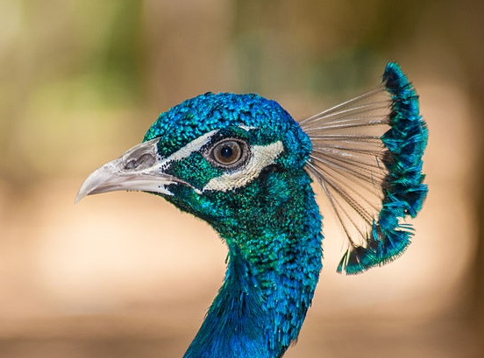
Complex Image Example
A male peacock with a metallic blue crown. Around his eyes and beak, the short-curled feathers are an iridescent turquoise. Above the eye is a white stripe and below the eye is a white crescent shape; both are formed by bare white skin. A fan-shaped crest appears on the back of the head, made of feathers with thin bare black shafts and tipped by bright blue and greenish tufts of feathers.

Slide 8
Making Complex Images Accessible

Slide 9
Accessible Complex Images, Part 1
To ensure accessibility for complex images, each image should include the following:
The image: If you have a static image, you can use the image without modifying it. If you have a chart or a graph created in Microsoft Excel or a similar program, take a screenshot of the image. The image should be visible on the screen.
A caption: The caption should identify what the image is of, and should be visible on the screen. (e.g., “Figure 1: Map of Greece,” “Table 3: Revenue Growth in Quarter 3 of 2024,” etc.)

Slide 10
Accessible Complex Images, Part 2
In addition to the image and caption, you should also include the following:
The long description: This can take many different forms (paragraphs, tables, bulleted lists, etc.) and be located in different places in a document. It should always be visible on the screen.
Alt-text: Alt-text should still be entered for the image. This alt-text should identify the name of the image and indicate where the long description can be found. The alt-text is not visible on the screen.

Slide 11
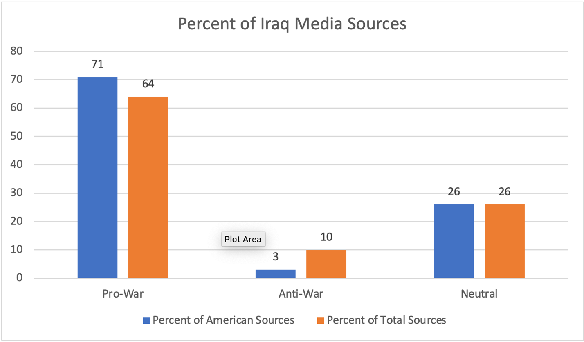
Accessible Complex Image Example
In their analysis of the media coverage of the Iraq War, Steve Rendell and Tara Broughel concluded that media’s attitudes toward the war were not universally consistent. Indeed, Rendell and Broughel show that coverage varied between pro-war, neutral, and anti-war. The sources they evaluated were largely pro-war, with American news sources coming in at 71% and total sources coming in at 64%. Neutral coverage came in at 26% for both American and other media sources. Anti-war attitudes were slight, with a mere 3% of American sources and 10% total sources opposing the war.
Chart 1: Percent of Iraq Media Sources
Table 1: Percent of Iraq Media Sources

Slide 12
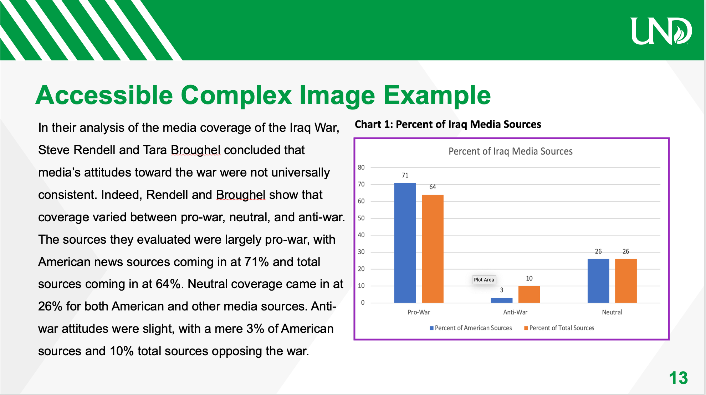
Image Example

Slide 13
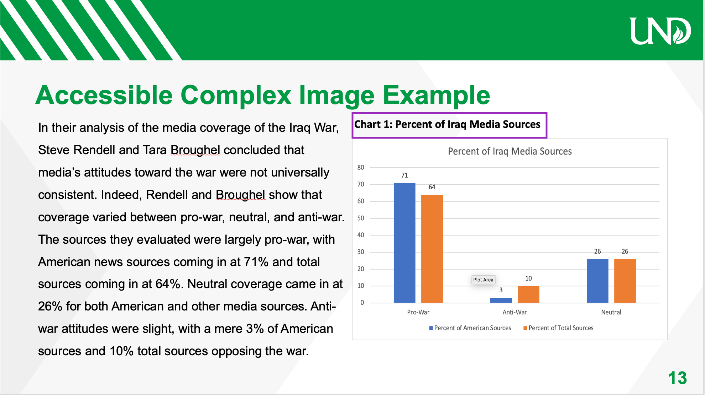
Caption Example

Slide 14
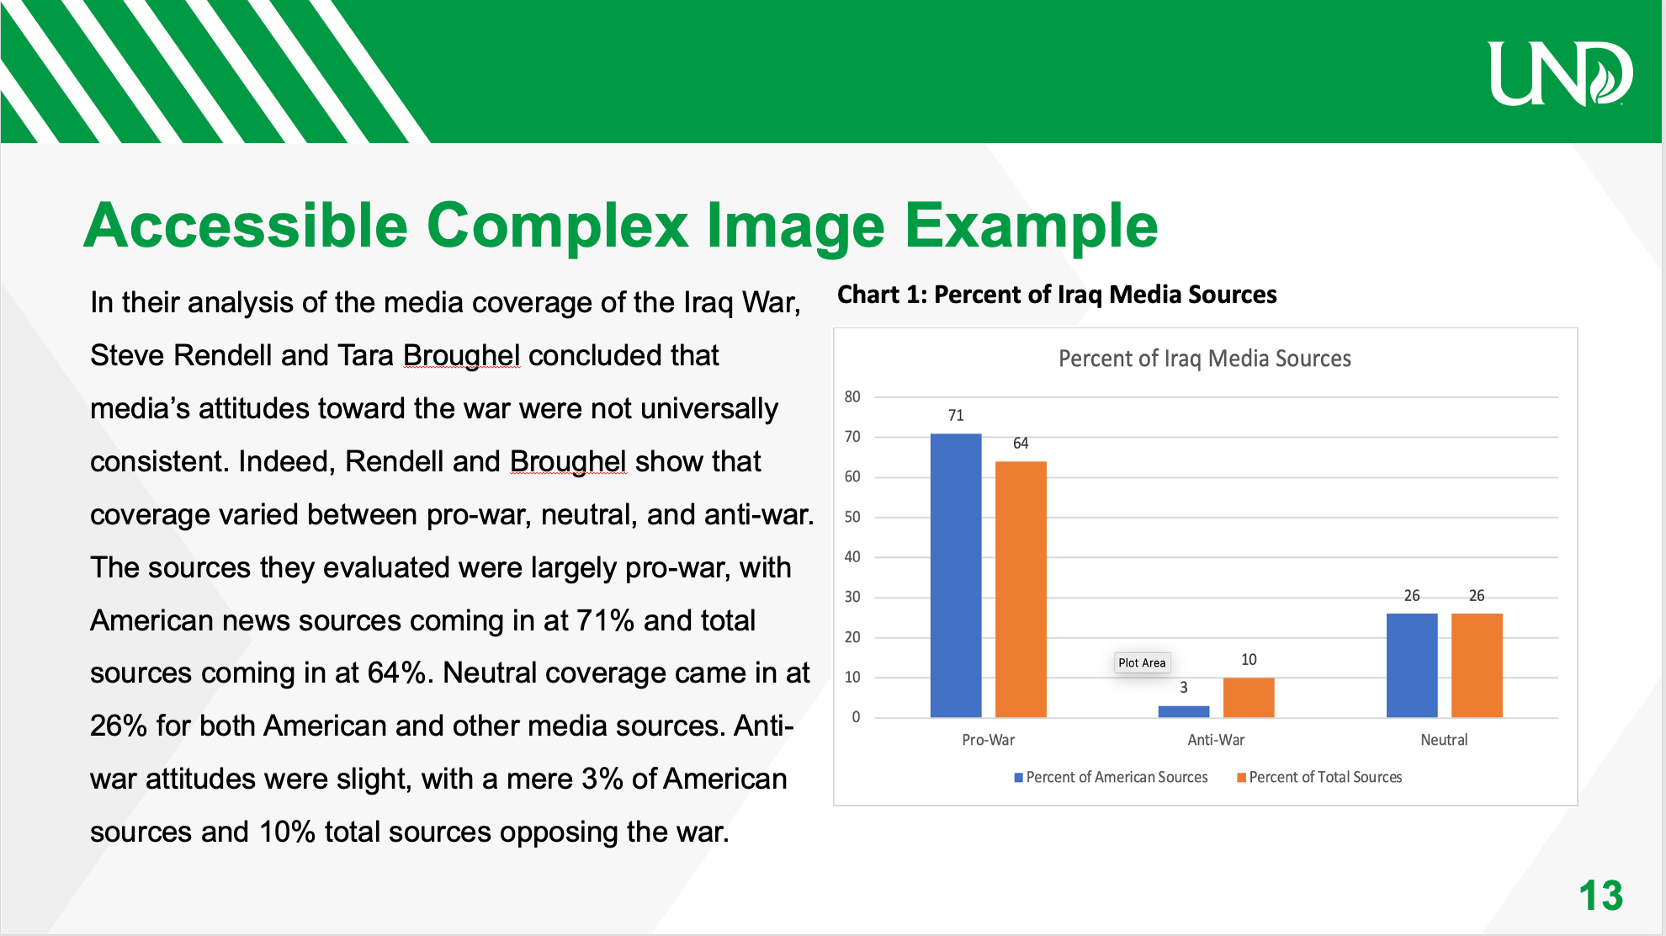
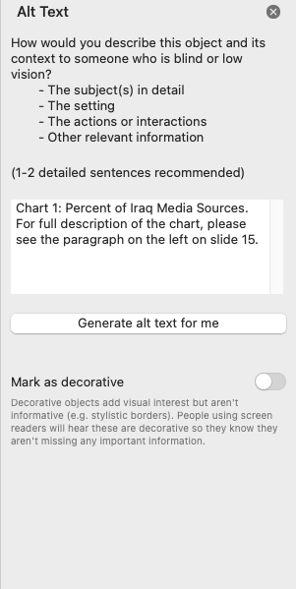
Caption Example
Alternative Text
Example

Slide 15
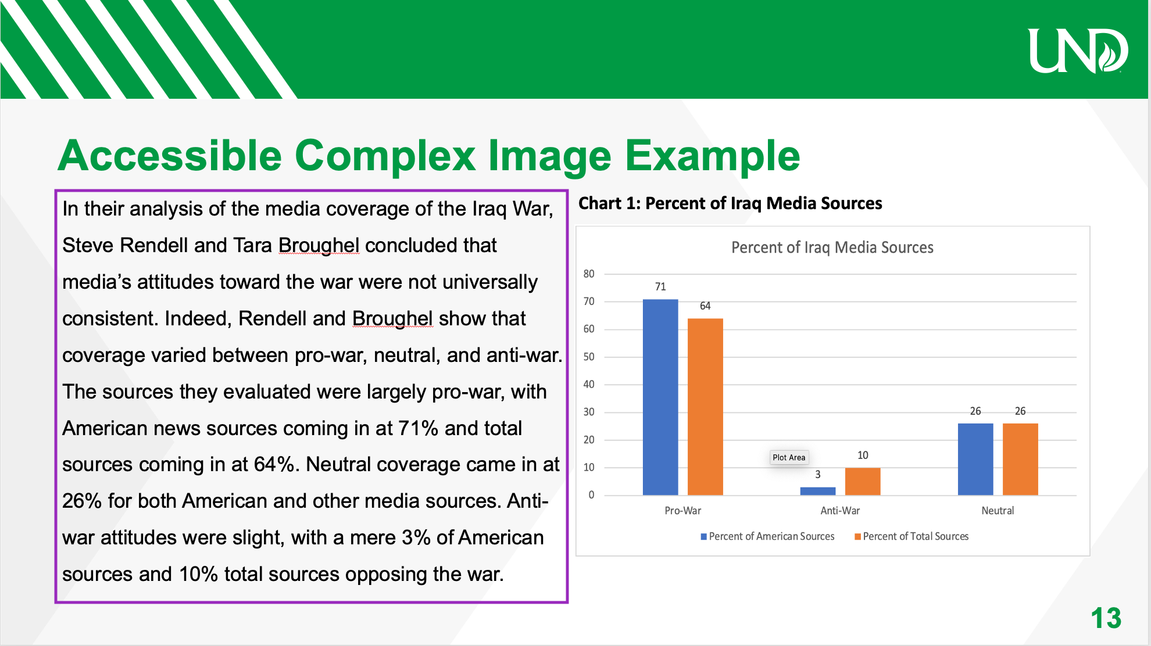
Long Description Example

Slide 16
Long Description Format(s)

Slide 17
Long Description Format(s), Part 1
Here are a few options to support complex image accessibility:
Paragraph(s) of text: these should ideally be positioned close to the image (either above or below in a Word document, on the same slide or the next slide in PPTX)
A simple table: Sometimes slightly more complex bar or pie chart data can be presented in a simple table format
A list of data points: Sometimes slightly more complex bar or pie chart data can be presented in a list format

Slide 18
Long Description Format(s), Part 2
Here are some more options to support complex image accessibility:
Video content: If you have described the image in full detail in a lecture video – and please note that you must describe the full detail of the image – you can indicate the title of the video and exact timestamp the description begins
Appendices, Notes, or external websites: You can link to any of these that are appropriate and that your audience will have access to in the body of your text – just remember, you can’t add links to alt-text

Slide 19
Writing Alt-Text &
Long Description for Complex Images

Slide 20
Step 1: Write Alt-text
Alt-text for complex images is simple, consisting of two phrases:
An identification of the image. Use the words in the caption, e.g., “Figure 1, Table 3, Diagram 16.1,” etc.
A phrase telling the listener where the long description is located.
Example: “Chart of Percent of Iraq Media Sources. For the full description, see text to the right of the image on Slide 10.”

Slide 21
Step 2: Write Long Description, Part 1
Long description can get very complicated because a complex image is…complex. Consider the following when writing long description:
Identify the type of image in the first sentence. Knowing what type of image (cartoon, bar graph, pie chart, diagram, illustration, illustration) is being described is essential for comprehension.
Summarize the point of the image in your second sentence. Identifying the overall point of the information being presented provides important context and direction.

Slide 22
Step 2: Write Long Description, Part 2
Use spatial references. What is on the right side of the image? In the top corner? Left side of the image? Lower bottom quadrant?
  Example: If you are describing a diagram of a series of steps in a process, where is Step 1 in that process located? What is is called? Where is Step 2 located? What is it called?
Use x- and y-axis. If you are working with a chart or a graph that uses a x- and y-axis, identify what each axis measures.

Slide 23
Special Note on Video Content
If you are using complex images in video content and you are accompanying the video content with a digital document (.PPTX or .DOCX), keep the following in mind:
You CAN supply your long description in the video ONLY IF
  You actually narrate a full description of the image in the video
  You provide alt-text on the video embed in Word or PowerPoint
  You provide the timestamp that the narration begins at in the alt-text field

