Slide 1


Effective Course Design: Destination Planning
Dr. Kristi N. Embry

Slide 2

Overview
Introductions
Getting Started
Destination Planning: Trips
Destination Planning: Courses

Slide 3
Introductions

Slide 4

Kristi Embry, Ph.D
Ph.D, Purdue University
Taught over ten years in higher education
Instructional Designer
Specializations include: Universal Design in Learning (UDL), accessibility, backwards course design, transparent design

Slide 5
Getting Started

Slide 6
Key Analogy
  Trip Planning :: Course Design

Slide 7
Backward Course Design
What is Backward Design?
  Coined by Wiggins & McTighe in Understanding by Design (1998)
  Purposeful design approach that considers the pedagogical destination and plans backward from there
  Learner-focused approach that focuses on what is learned, instead of what is taught

Slide 8
Destination Planning: Trips

Slide 9
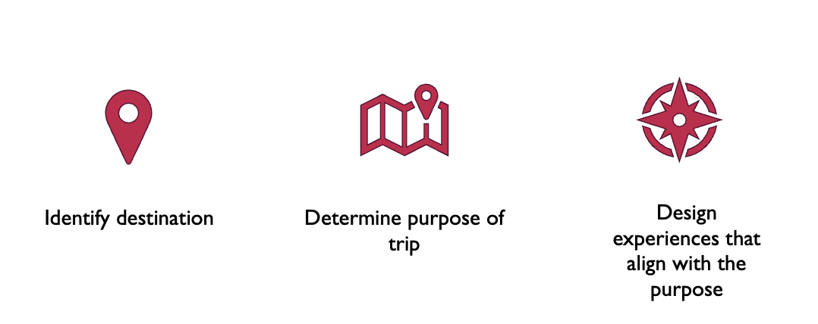
Three Steps

Slide 10
Destination Planning Example
Identify Destination: NYC 2024
Determine Purpose: Fun/Pleasure
Design Experiences: Museum trips, Broadway muscials, sightseeing, and culinary experiences

Slide 11
Verbs, Verbs, Verbs
Effective trip planning comes down to verbs
Strong action verbs
Measurable

Slide 12
A Good Trip…
Can be measured by strong verbs
Create a budget
Map travel routes
Arrange transportation, hotel, etc.
Pack clothes
Buy tickets, meals, souvenirs
Visit museums
Attend Broadway shows
Have fun!

Slide 13
Destination Planning: Courses

Slide 14
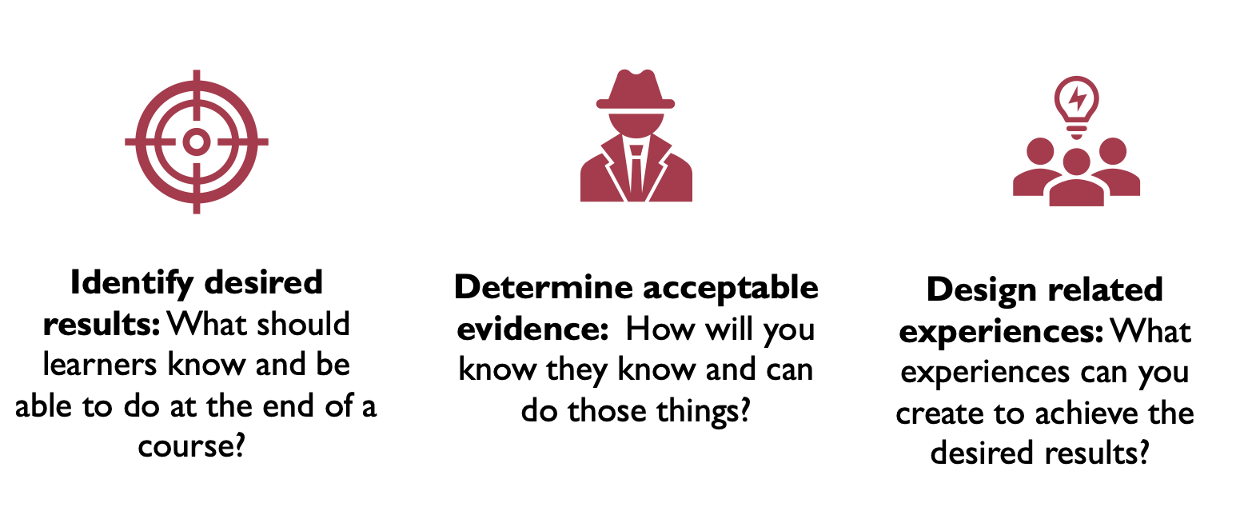
Three Steps

Slide 15
More Verbs
Bloom’s Taxonomy
Created by Benjamin Bloom in 1956 (University of Chicago)
Hierarchical classification of learning levels
Learning levels build on each other
These learning levels can be used to determine course objectives, outcomes, activities, and assessments

Slide 16
Measurable Actions
Verbs used to create learning journeys should:
Be strong
Be measurable

Slide 17
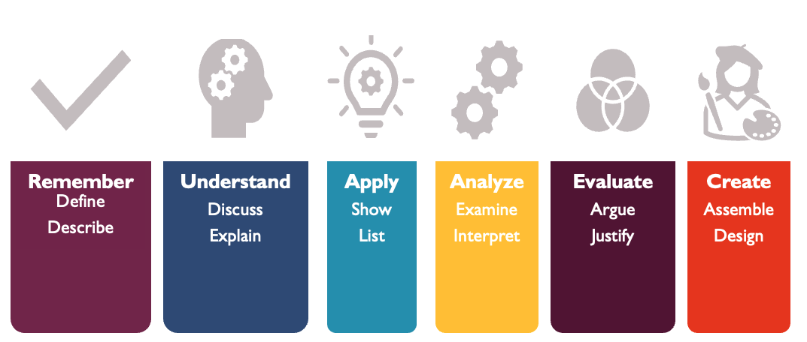
Bloom’s Taxonomy

Slide 18
Bloom’s Taxonomy Resources
For more on Bloom’s Taxonomy see the following resource:
Want a tool to help you navigate learning objectives, measurable verbs, and possible activities/assessments? Check out Writing Module Learning Objectives (MLOs) Using Bloom's Taxonomy for Quality Matters™ Online Course Review and Certification

Slide 19
Sample Course
Course Title: British Literature II
Type of Course: General survey of British literature 1789-present day
Learner Level: Primarily sophomore and junior non-majors
Learner Purpose: Fulfill Gen-Ed requirements/pre-reqs

Slide 20
Identify Desired Results
The destination of my course/learning journey is determined by learning outcomes:
Course Outcome 1: Learners should be able to identify major historical, cultural, and literary movements between 1789 and present day
Course Outcome 2: Learners should be able to analyze literature

Slide 21
Determine Acceptable Evidence
Learning objectives create a learning path and ”mile markers” that prove learners are making progress on their learning journey:
Lesson Objective 1: Learners should be able to identify the sublime, the beautiful, and the picturesque in 19th century visual and literary arts
Lesson Objective 2: Learners should be able to analyze visual and literary examples of the sublime, the beautiful, and the picturesque in literary art

Slide 22
Design related Experiences
Course resources and assessments provide the supports that prove steps are being taken in the right direction toward the final learning destination:
Course Resources: PowerPoint slide presentations, textbook readings, various Romantic-era paintings, and Wordsworth’s “Tintern Abbey” and Shelley’s “Mont Blanc.”
Assessments: Romantic Painting Discussion board (formative activity); Reading Quiz (formative activity), and The Sublime, Beautiful, and the Picturesque Essay (analytical essay)

Slide 23
Questions?

Slide 24
Thank you!

